Slide 1

Spring Framework

Slide 2
FEATURES
INVERSION OF CONTROL
ASPECT ORIENTED PROGRAMMING
CONTAINER
CONVENTION OVER CONFIGURATION
NON INVASIVE
E2E DEVELOPMENT
SUPPORTS ALL TYPE OF APP DEVELOPMENT
VERSATILE
PREDEFINED TEMPLATES
WORKS ON POJOS (plain old java objects)
EXTERNALIZED CONFIGURATION & PROFILES

Slide 3
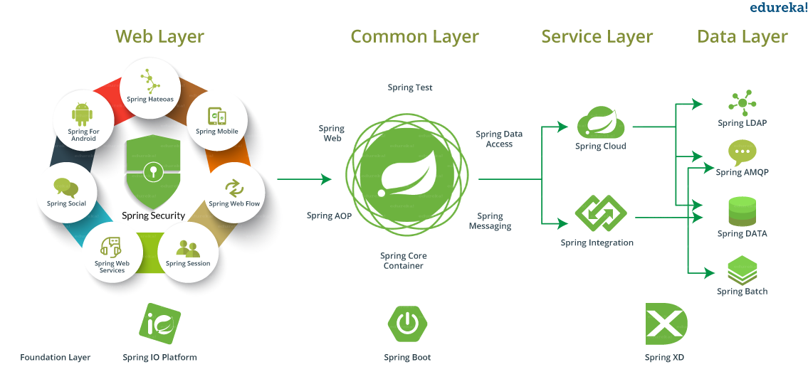
MODULES

Slide 4
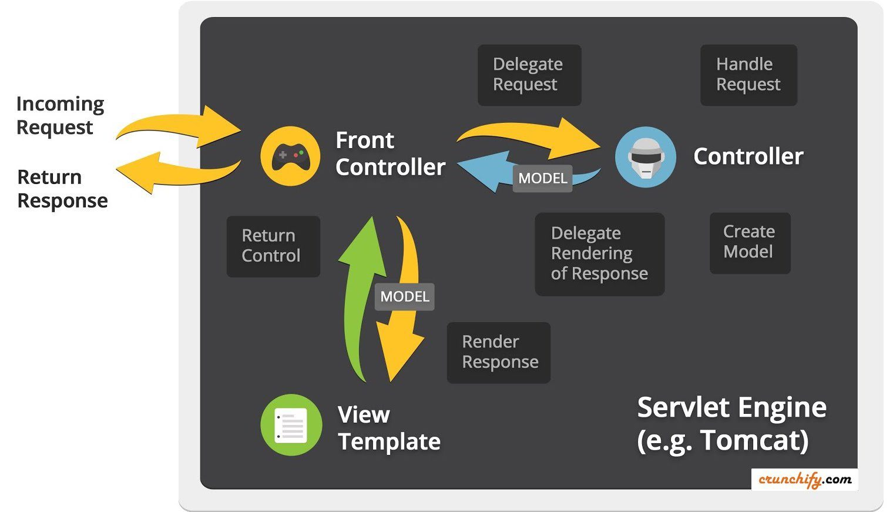
SPRING MVC

Slide 5
EXAMPLE - MVC
https://github.com/viralpatel/spring4-mvc-example

Slide 6
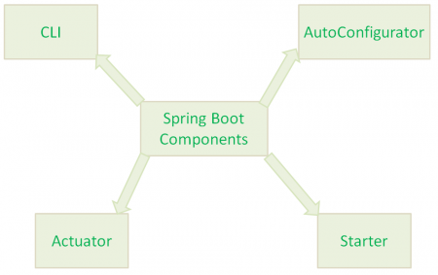
SPRING BOOT
http://www.baeldung.com/spring-boot-actuators

